Slide 1


CS-482: Introduction to Blockchain and CryptoCurrency
Lecture # 12: The Future of Bitcoin
Prof. Dr. Sufian Hameed
Department of Computer Science
FAST-NUCES

Slide 2
Decentralize everything!

Slide 3
The block chain as a vehicle for decentralization

Slide 4
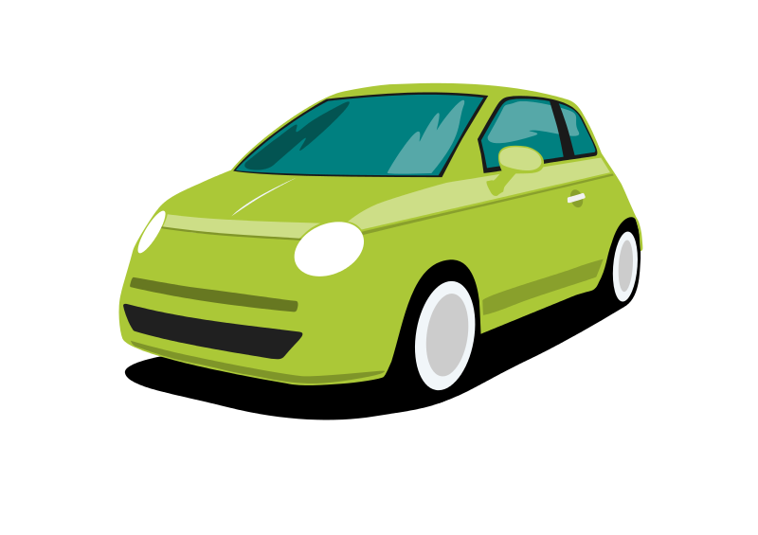

Motivating example: smart property
Step 1: car controlled by a
cryptographic key
Car has public key hard-coded
Activated upon receiving message signed by corresponding private key

Slide 5

Motivating example: smart property
Step 2: public key is dynamically updated based on Bitcoin block chain
Alice owns the car because she controls private key of green Tx output
signed by A
Now Bob’s key activates car
Transfer
Pay to pk_{B}: H( )

Slide 6

Motivating example: smart property
Step 3: Create a single transaction that combines Bob’s payment to Alice and Alice’s ownership transfer to Bob
Alice and Bob sign separately, then broadcast

Slide 7
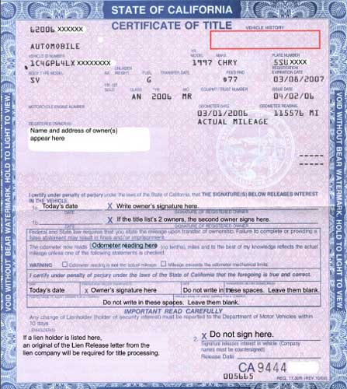
Decentralized property ownership

Slide 8
Representation and atomicity
Representation:
How to encode complex transactions into the block chain?
Atomicity:
How to couple the actions of the various parties?

Slide 9
Questions
What else can we decentralize this way?
Can these be done on Bitcoin or do they require a separate block chain?
Are there alternatives to atomicity?
Is it a good idea to do commerce like this?

Slide 10
Routes to block chain integration

Slide 11
Route 1: Directly on Bitcoin
Advantage:
easy to deploy
Disadvantages: limited representation and atomicity

Slide 12



Example: crowd funding
Single Tx with arbitrary number of inputs and 1 output
Spendable only if Σ(inputs) ≥ output
Each funder signs only her own input and the output
2
5
1000
…
4

Slide 13
Example: pay for proof
Alice knows x such that H(x) = c
Bob would like to pay Alice in exchange for x
Bob’s Payment should be atomically coupled with Alice’s publication of x on block chain
Possible but unwieldy

Slide 14
Route 2: Embedding
Recall: Colored coins
Similar to representation of car ownership, but relies on entire history
Recall: Mastercoin

Slide 15
Route 2: Embedding
Advantages:
Complex representations possible
Security of Bitcoin block chain
Disadvantages:
Limited scripting and atomicity
Results in unwanted Tx’s in block chain

Slide 16
Route 3: Side chains
Recall:
merge-mined, 1-1 pegged Bitcoin testbed
Advantage:
Avoids polluting the block chain
Disadvantage:
Requires Bitcoin modifications

Slide 17
Which approach to use?
Conceptually, any of the four can implement smart property
Differences in power and flexibility
Practical differences, e.g: SPV feasibility

Slide 18
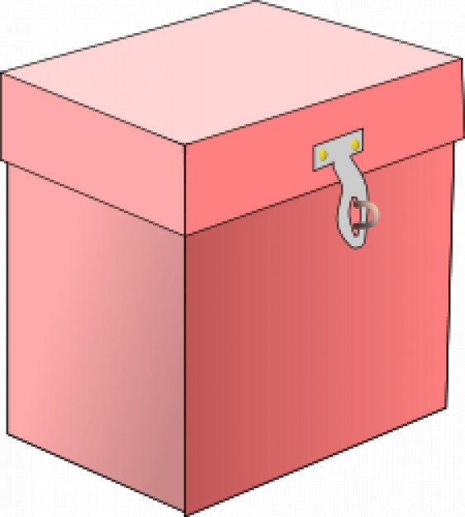
Back to the car sale example
What about a dispute?
Recall: 2-out-of-3 escrow
2-out-of-3:
Alice, Bob, Judy

Slide 19
Comparison to legal remedy
Advantage(?):
Alice and Bob have freedom to choose mediator Judy
➔ competition between intermediaries
Disadvantage:
Funds tied up during mediation

Slide 20
Competing intermediaries
Recall: decentralized prediction market achieved by allowing anyone to start a market

Slide 21
Levels of (de)centralization
Single mandatory intermediary
Multiple competing intermediaries
“Threshold” of intermediaries
No intermediary

Slide 22
Improving security
Reputation
Escrow & dispute mediation
Atomic exchange
Trusted hardware
Limitations due to lack of real-world enforcement:
no debt or punitive measures
Seen so far

Slide 23
Security: vocabulary
Trust minimization
Lack of trust is (unfortunate) starting point, not a goal!

Slide 24
A generic decentralization template
What is being decentralized
Type of block chain integration
Level of decentralization
How security is achieved
Seen so far
Allows succinctly representing almost any
proposal for block chain based decentralization

Slide 25
Example: smart property
Decentralizes
in the sense of
using
via
property ownership and trading
disintermediation
Bitcoin
atomicity

Slide 26
Example: decentralized prediction markets
Decentralizes
in the sense of
using
via
prediction markets
competition
an Altcoin
atomicity

Slide 27
Example: StorJ
“Agent” that lives in the cloud
Pay to store a file for fixed period (say 1 day)
Has other aspects such as reproduction
(ignore for now)

Slide 28
Example: StorJ
Decentralizes
in the sense of
using
via
file storage and retrieval
competition
Bitcoin
reputation

Slide 29
Example: Zerocoin
Decentralizes
in the sense of
using
via
mixing
disintermediation
an Altcoin
atomicity

Slide 30
What can we decentralize?

Slide 31
1. Purely digital things
Name mapping
Storage
Pay for proof
Random number generation
Lotteries

Slide 32
2. Things that can be represented digitally
Real-world currencies
Stocks
Other assets

Slide 33
3. Property ownership and trade
Smart property and atomic exchange

Slide 34
4. Complex contracts
Crowd funding
Financial derivatives
Requires price data feed unless underlying asset is traded on block chain

Slide 35
5. Markets and auctions
Centralized markets:
Used bike store — buys your bike, sells it later
EBay — matches participants, routes payments
PayPal — processes payments, (some) dispute mediation
Craigslist — matches participants

Slide 36
How to decentralize markets
Payment
Transfer of goods
Dispute handling
Matching participants
Bitcoin
smart property, atomicity
escrow
??

Slide 37
Decentralized matching
Broadcast partially complete transaction to P2P network
Counterparty finds it, completes, signs, broadcasts
Variant: use block chain instead of P2P network

Slide 38
Variant: auction
Counterparty can’t complete directly, must return to auction creator

Slide 39
Variant: double auction (order book)
Both sides simultaneously broadcast partial transactions
Miners match orders, keep bid-ask spread (Avoids miner front-running)

Slide 40
6. Data feeds
Recall:
data feeds allow arbiters to assert facts about the world into the block chain
Examples:
price movements, outcomes of events…
Big incentives to lie!

Slide 41
Decentralization by voting
Centralized version: Tx corresponds to event E with outcomes X, Y, Z
Transfer to pk_{X} if outcome X happens
Signed by arbiter A
E
signed by A
Transfer
Pay to pk_{X}: H( )

Slide 42
Decentralization by voting
Decentralized version:
E is a 2-out-of-3 multi-sig address controlled by A, B, C
E
signed by A, C
Transfer
Pay to pk_{X}: H( )

Slide 43
Levels of (de)centralization
Single mandatory intermediary
Multiple competing intermediaries
“Threshold” of intermediaries
No intermediary

Slide 44
7. Autonomous agents
Key features
Contracts
Data feeds
Voting as a way to change the rules
Some variants: reproduction
Challenges
Keeping private state
Hostile takeover

Slide 45
Autonomous agents: terminology
Decentralized Autonomous Corporation
Preserves few of the salient features of corporations

Slide 46

8. Exchanges
The problem:
Alice would like USD for BTC
Carol would like BTC for USD
They don’t trust each other
Luckily, they have a mutual friend Bob
A
B
C

Slide 47
Let’s make this more efficient
I owe you $100
I owe you $100
A
B
C

Slide 48
And scale it up
Pairs of friends pre-declare how much debt they’re willing to extend
IOU

Slide 49
Ripple
Decentralizes
in the sense of
using
via
currency exchange
disintermediation
an Altcoin
transitive trust

Slide 50
When is decentralization a good idea?

Slide 51
What we’re really talking about:
Technological alternatives to human institutions — legal, social and financial
Recall: Cypherpunk roots

Slide 52
Back to the car example
What are the problems with car ownership and trade?
Security (theft)
Disputes about sale terms
What happens in a smart property model?

Slide 53
Security is complex
Preventive, detective and corrective controls
Real-world solution relies on law enforcement

Slide 54
Bitcoin security
Unsolved problem for the foreseeable future
Software security is partly a human problem
Excessive reliance can cause serious problems
Loss of key → car turns into brick?

Slide 55
Dispute mediation is complex
Fundamentally a human problem
Real-world solution: court system, especially small-claims courts

Slide 56
Crowd funding security
Also fundamentally a human problem
Entrepreneur can take the money and run

Slide 57
Smart property model
Didn’t solve existing (social) problems
In fact, made them harder to solve
Introduced new problems

Slide 58
Possible benefits of smart property
Efficiency for small transactions
Anonymity & privacy
Freedom to choose mediator

Slide 59
Crypto and the state
The state is one way to scale society past small groups where everyone trusts each other
Crypto is another
Dismantling the state is not an option
How can the two work together?

Slide 60
The big opportunity
Find compelling use-cases for decentralization
Integrate into existing systems
Co-opt legal and regulatory practices

